Slide 1
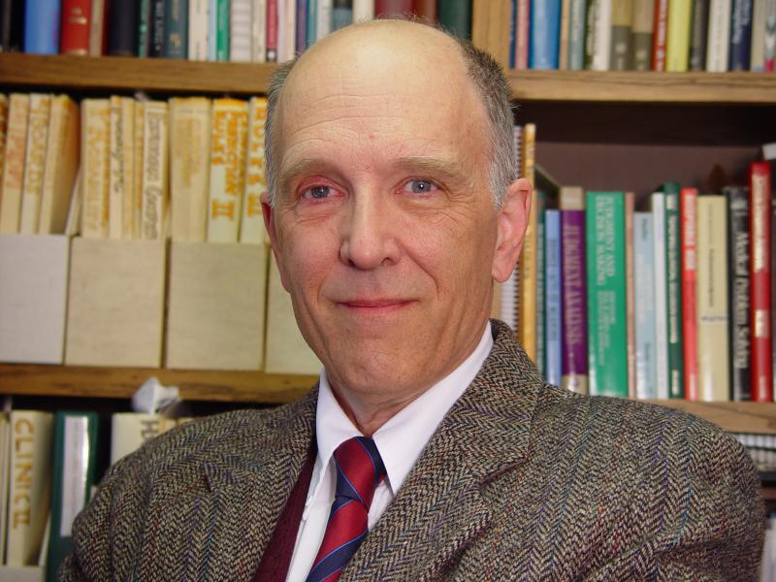
Robert S. Wigton – 1942-1982 Contributions to Brunswikian research in medicine – Thomas G. Tape, MD Professor Emeritus, Internal Medicine University of Nebraska Medical Center tgtape@unmc.edu
December 2022

Slide 2
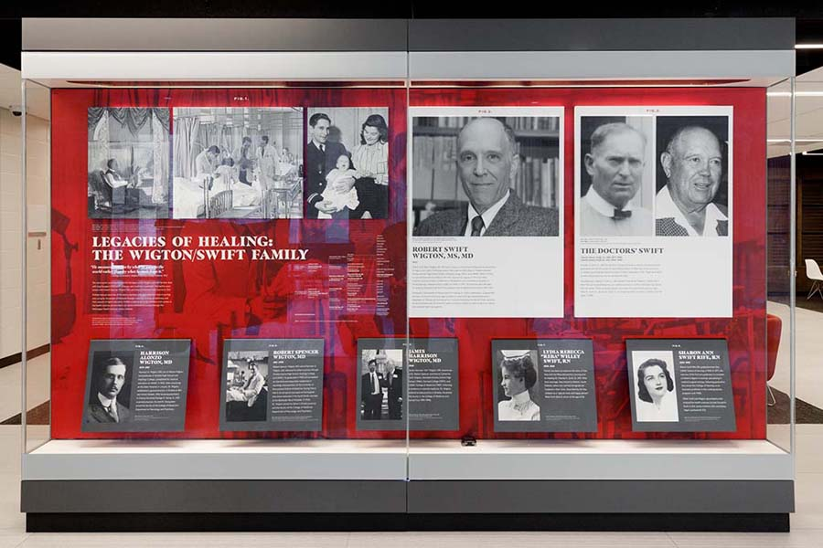
Generations of healers in Bob’s family
–
17 members of the Wigton/Swift family in health sciences dating back to both of Bob’s grandfathers who were Nebraska physicians.
https://wigton.unmc.edu/LegaciesHealing

Slide 3
Bob’s brief bio
Born in 1942 and raised in Omaha, Nebraska
BA Harvard College (English literature major)
MD University of Nebraska College of Medicine Class of 1969
Residency & Chief Residency, Internal Medicine, Nebraska
MS University of Nebraska College of Medicine (Physiology, 1973)
Nebraska Medical Center faculty member 1972−2022
Associate Dean, Graduate Medical Education 1976−2013
Section Chief, General Internal Medicine 1993−2002
Authored > 160 publications
Medical judgment & decision making
Procedural skills training
Computer-based medical education
Wide ranging interests outside of medicine:
History of Medicine
Painting & digital photography
Hiking & Gardening
Science fiction
Cartooning, animation, jazz performance, dirt motorcycles

Slide 4
Bob’s early research career (pre-Brunswik)
1973-1981
Teaching physiology
“The physiologic basis of arrhythmias: a programmed text.” (1973)
“Tiered tutoring in physiology.” (1974)
Medical education
“New directions in postgraduate training in internal medicine.” (1973)
“Graduate medical education at the University of Nebraska: A ten year survey.” (1979)
“Factors important in the evaluation of clinical perfor­mance of internal medicine residents.” (1980)
“The effects of student personal characteristics on the evaluation of clinical performance.” (1980)
Improving Medical Practice
“Chart reminders in the diagnosis of anemia.” (1981)
“A method for selecting which procedural skills should be learned by internal medicine residents.” (1981)

Slide 5
Bob’s sabbatical: September 1982–June 1983
Advice from Department Chair (paraphrased): “Stop being a dilettante and find an area of focus for your research!”
Bob obtains a position at the University of Pennsylvania as a visiting scholar for a period of 10 months starting in the fall of 1982.
His focus would be on the psychology of judgment and decision making:
Conjoint analysis
Fractional factorial designs
First research results of this new direction:
“Enhanced learning of clinical diagnosis through computer graphics feedback of diagnostic weighting.” (1984)
“Use of clinical findings in the diagnosis of urinary tract infection in women.” (1985)
“How physicians use clinical information in diagnosing pulmonary embolism: an application of conjoint analysis.” (1986)
“Transportability of a decision rule for the diagnosis of streptococcal pharyngitis.” (1986)
The effect of feedback in learning clinical diagnosis. (1986)

Slide 6
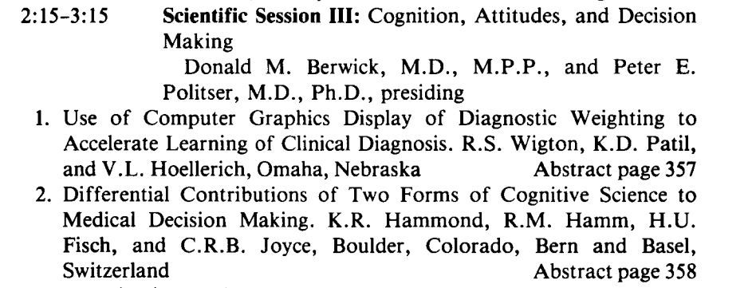
Bob becomes aware of Ken Hammond’s work

Slide 7
Bob’s first published feedback study:
Wigton RS, Patil KD, Hoellerich VL
Enhanced learning of clinical diagnosis through computer graphics feedback of diagnostic weighting.
Proceedings of the 23rd Annual Conference on Research in Medical Education, 23:111-116, 1984.

Slide 8
Bob’s first published feedback study (Methods)

Slide 9
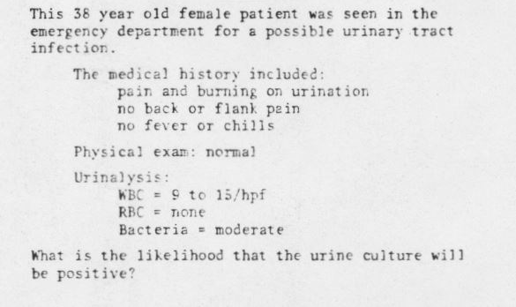
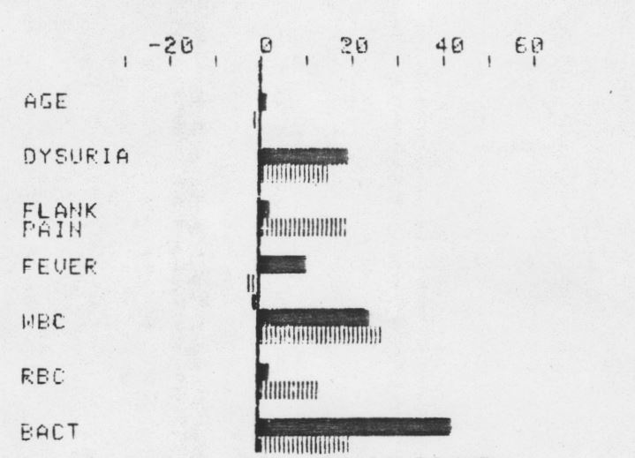
Bob’s first published feedback study (Vignette & CFB*)
*Cognitive feedback

Slide 10
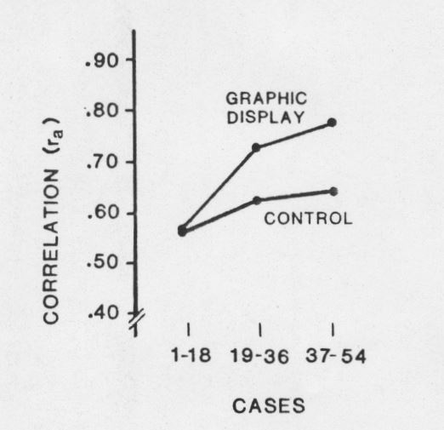
Bob’s first published feedback study (Results)
<= CFB + Calc. prob.
<= Calc. prob. only

Slide 11
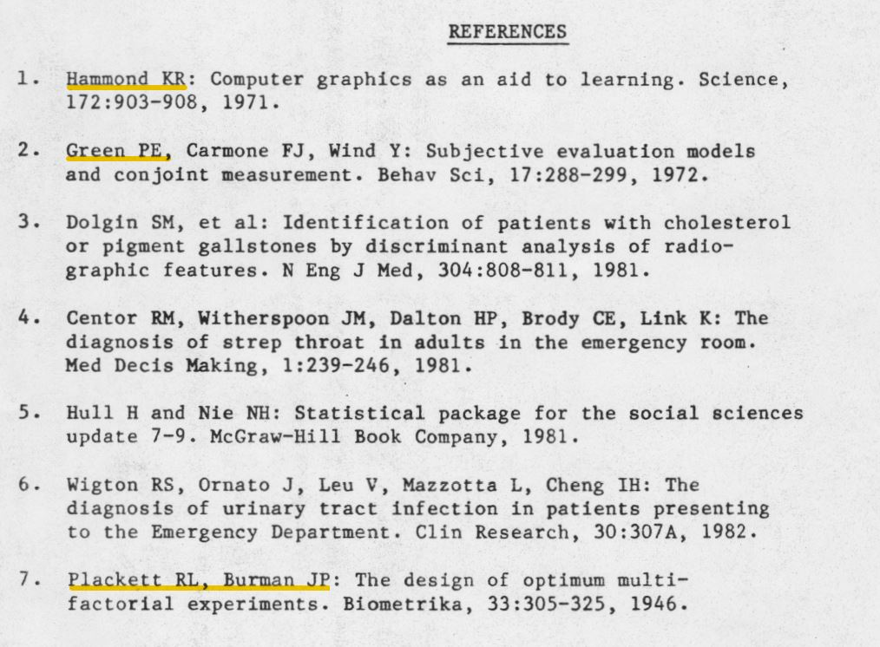
Bob’s first published feedback study (References)

Slide 12
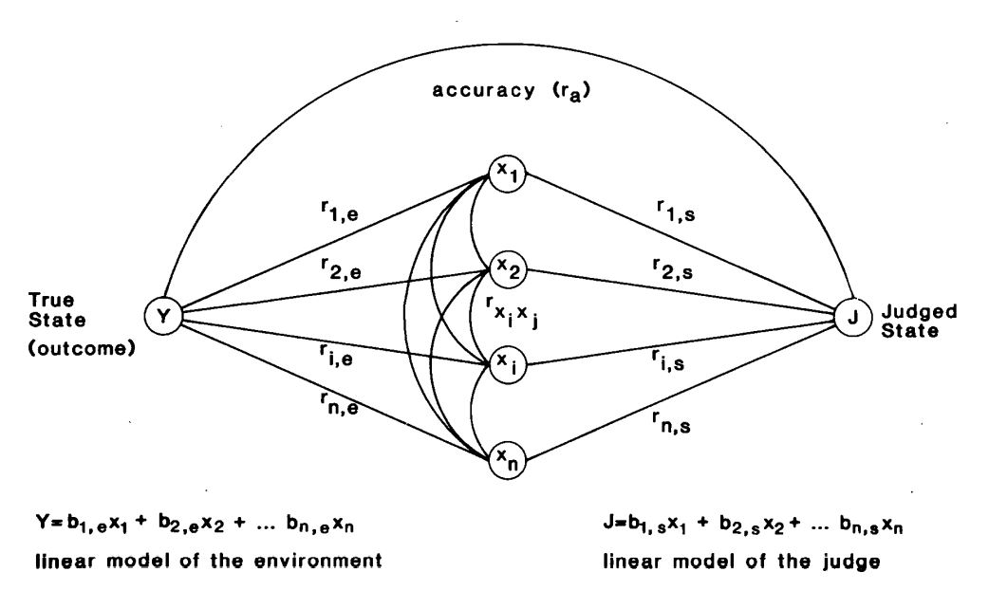
1988: Bob Publishes Linear Model MDM Review Paper
Wigton RS: Use of linear models to analyze physicians' decisions. Medical Decision Making 8:241-252, 1988.
(Bob’s first visual representation of Brunswik’s Lens Model)

Slide 13
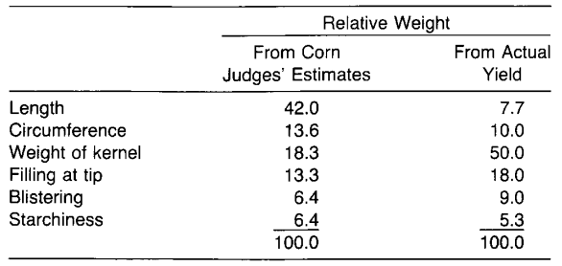
MDM 1988 Paper Part I: Linear Models Literature Review
The “Corn Judge” study
Wallace HA: What is in the corn judge’s mind? J Am Soc Agronomy 15:300-04, 1923
Experienced corn judges estimated the future yields from 500 ears of corn
Judges’ accuracy was poor
Judges focused on the wrong factor
Insights from Brunswik’s Lens Model studies
Considerable variation among expert decision makers
Weights derived from the judges’ answers outperformed models using their stated weights
Survey of Research using linear models to study medical judgment
Poor agreement among physicians in how to use clinical information
Differences in cue weighting explain much of the variation
The model of physician judgment can be applied to reduce variation in individual judgment
Judgments in response to simulated cases closely resembled those made with actual patients
The value of “cognitive feedback” to improve diagnostic accuracy
Simple models with unit weights and no interactions often perform well

Slide 14
MDM 1988 Paper Part II: Methods Tutorial
Design of Cases
Representative design
Full factorial design
Fractional factorial design
Selection of Variables (cues)
Number of cues
Problems with omitted cues & recognizing when important cues are missing.
Representation of cues
Range of values over which the cue is varied
Number of cue levels represented
Order of cue presentation
Method of Analysis
Regression vs. analysis of variance (including conjoint analysis)
Individual vs. group level of analysis (idiographic vs. nomothetic)
Future Directions
“There are reasons to believe linear models will be the most productive route for studying medical decisions. They consistently match or outperform experts in prediction in their own areas.”

Slide 15
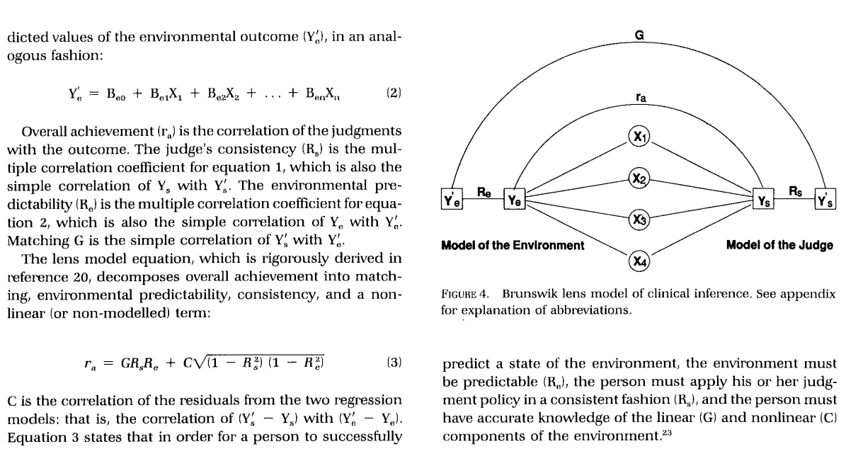
Application of The Lens Model Equation
Tape TG, Heckerling PS, Ornato JP, Wigton RS:
Use of clinical judgment analysis to explain regional variations in physicians' accuracies in diagnosing pneumonia.
Medical Decision Making 11:189-197, 1991.
Appendix:

Slide 16
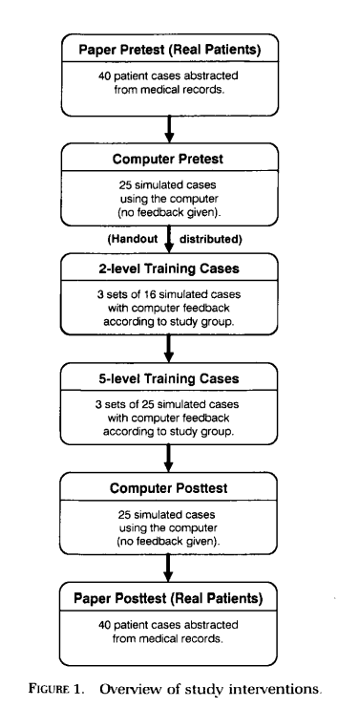
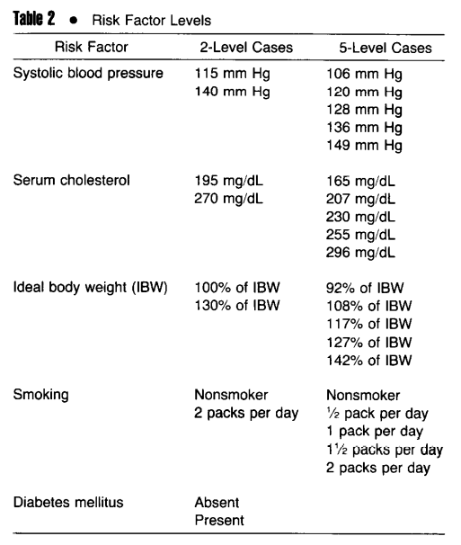
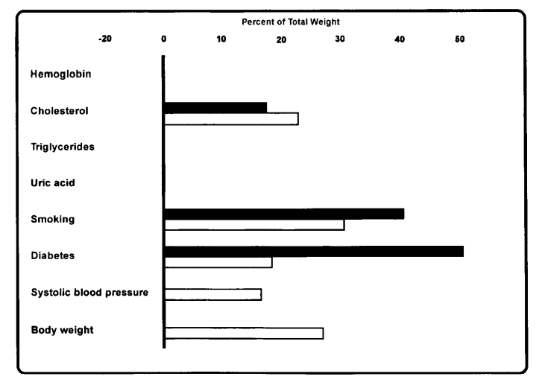
What type of feedback is most effective? - Methods
Tape TG, Kripal J, Wigton RS:
Comparing methods of learning clinical prediction from case simulations. Medical Decision Making 12:213-221, 1992.
Total of 253 cases

Slide 17
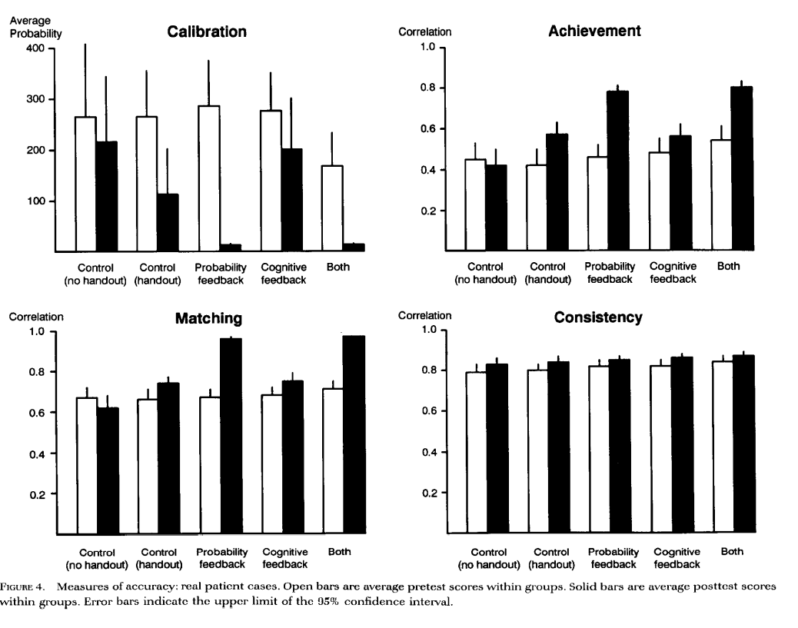
What type of feedback is most effective? – Real Cases

Slide 18
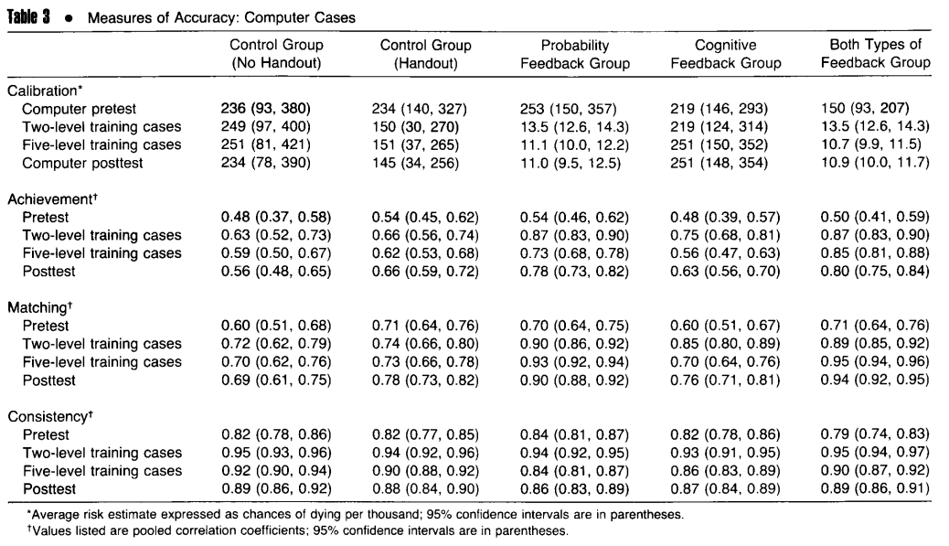
What type of feedback is most effective? – Computer Cases
Similar results to real cases
CFB group seemed to struggle with 5-level cases

Slide 19
What type of feedback is most effective? – Conclusions
Probability feedback very important for calibration (expected)
Probability feedback very important for achievement (unexpected)
Task information also helpful (handout plus prior experience)
Why were these results different from UTI (and other prior studies)?
UTI study compared CFB to control (both got probability feedback)
MCPL studies generally used abstract cues with complex function forms
True outcome feedback incorporates an error (uncertainty term)
Adelman showed correct labeling of cues makes a difference
Take home point: Optimal type of feedback may depend on the type of task

Slide 20
Bob’s Judgment Research Studies & Collaborations
UTI – Vince Hoellerich, Kash Patil, Joe Ornato; Steve Flach, JC Longenecker, etal
Pharyngitis – Bob Centor, Roy Poses, Randy Cebul
Lymphadenopathy – Gail Slap, Sandy Schwartz
Tube Feeding – David Gary Smith
Pulmonary Embolism – Vince Hoellerich, Kash Patil
Pneumonia – Paul Heckerling, Joe Ornato, Tom Tape
Cardiovascular risk – Jerry Kripal, Tom Tape
Advance Directives – Tim Malloy, Tom Tape; Pat Raymark, Bill Balzer, Mike Doherty
Specialty choice – Marie Reidelbach
Opioid Prescribing – JHTamayo-Sarver, Neal Dawson, etal
Antibiotics in URI – Ralph Gonzales et al (US); N Safdar (US); Anzar et al (Argentina)
Hypothyroidism – Gay Canaris, Tom Tape

Slide 21
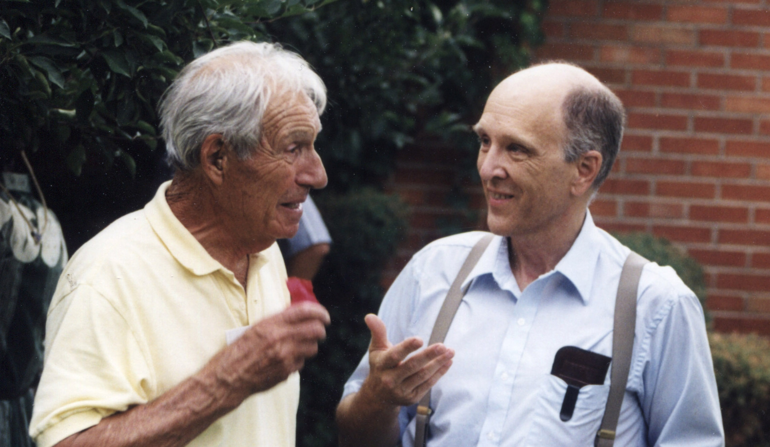
Summary
Bob Wigton did ground-breaking work in the application of Brunswik’s Lens Model to medical judgment tasks.
His development of desktop computer simulations with various types of feedback made clinical judgment learning feasible in a variety of settings.
Bob became a “go-to” resource for collaborators interested in judgment studies using fractional factorial designs and lens model applications.
Ken Hammond & Bob Wigton – 1999
tgtape@unmc.edu

