Slide 1
Bob Wigton’s Teaching about Brunswikian Research
Robert M. Hamm, PhD
Presentation at 2022 virtual meeting of the Brunswik Society
Internet, Earth
December 8, 2022

Slide 2
To Promoting Brunswik’s Theory and Method Broadly
Ken Hammond valued applying Brunswikian methods in other fields.
Best way – involve and engage field experts in the research
Identifying the judgments to study
Structuring the stimuli
Actually learning to apply the method and analyze it.
Medicine may be the “other” domain with the most lens model research.
And Bob Wigton perhaps took to it most productively.
Notes:
That third step is taken by few: Doing the analysis is not common.
Often, takes a team.

Slide 3
Bob Wigton was an early member of SMDM
Society for Medical Decision Making (SMDM) addresses both
the optimal medical decisions for particular diseases (decision analysis) and
how physicians (and more recently, patients) actually make decisions (judgment and decision making psychology).
I attended SMDM meetings 1979-1984, and 1992 on.
I worked for Ken in Boulder 1981-1984.
When Bob came to visit Ken I recognized him from SMDM.
Tom Tape: Bob’s lens model research.
Next: Bob’s lens model teaching at SMDM.

Slide 4
Bob’s Teaching at SMDM.
Bob’s biggest teaching contribution at SMDM was running the annual Student Presentation Awards for 2 ½ decades, from 1987 or 1988.
Get many volunteers to attend, and grade
Collate before last session.
In addition, he collaborated with Tom Stewart, Tom Tape, Esther Kaufman, in teaching the Brunswik Lens Model as a method, in 3 hour short courses at the annual meeting.
Several times before 1997
As late as 2010 and 2014.
Short courses are for physicians, researchers, and a few trainees.
Here is how he covered it – his section of the 3-hour course.
Notes:
Bob ran a similar program, judging student presentations at the Society for General Internal Medicine (check with Tom Tape – may have been a different IM society).
Note that while Bob’s actual presentation may not cover the broader aspects of Brunswik’s theory, that does not mean that he did not understand, appreciate, care about those things. Just not appropriate for a time-limited introduction.

Slide 5
Bob started with this lens representation of Henry Wallace’s 1923 study. “What’s on the Corn Judge’s Mind?”
Cues
Weights
length
r1
Actual yield
(environment)
Corn judge
estimate
Circumference
r2
E
J
weight
r3
r4
etc
Wallace in 1923 had no Brunswik Lens Model Equation
(Brunswik was 20 years old, Hammond 6).
But compared judges’ weights with actual weights.
Notes:
Comparing relative cue weights in judgment model and environment model is one of the most usable features of the lens model analysis, though is not the lens model equation.

Slide 6
Relative Weights (sum to 100) for predicting a corn field crop’s yield/acre.
Corn judges Actual yield
Length 42 8
Circumference 14 10
Wt of Kernel 18 50
Filling at tip 13 18
Blistering 6 9
Starchiness 6 5
100 100

Slide 7
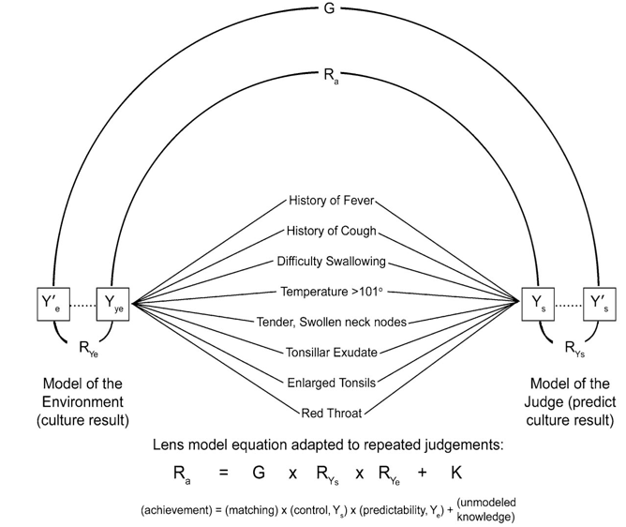
Outline of Bob’s part of short course.
A series of graphs, adding r_{a} and the linear model predictions,
Building up to the lens model graph and equation →
Multiple clinical examples
Described past research, his and others’
Stepped through “how to do a study”
A workshop where attendees design a study, collect data, analyze it with a linear model, compare weights to a published standard.

Slide 8
He emphasized the advantages of the Lens Model a.k.a. Policy Capturing, Judgment Analysis
Lens model equation -- can decompose elements affecting accuracy (achievement)
Can accurately predict an individual’s future decisions
Creates a model of decisions or judgments
Can study interactions among cues
Can describe policies of individuals
Uses explicit values of cues, not abstract
Models trade-offs
Measures accuracy, consistency and calibration
Notes:
He showed this slide at three points in the presentation.
The top and bottom items refer to the lens model per se; the middle all refer to the description of judgment, though some could also be applied to the model of the environment.

Slide 9
He emphasized the advantages of the Lens Model a.k.a. Policy Capturing, Judgment Analysis
Note that he defines “Lens Model” broadly – “policy capturing” produces only the model of the judge, no lens, no lens model equation.
Lens model equation -- can decompose elements affecting accuracy (achievement)
Can accurately predict an individual’s future decisions
Creates a model of decisions or judgments
Can study interactions among cues
Can describe policies of individuals
Uses explicit values of cues, not abstract
Models trade-offs
Measures accuracy, consistency and calibration
Notes:
Calibration. Bob did that with probability, but not through the lens model (see Lee and Yaes; Gigone and Hastie; Bago d’Uva and O’Donnell, 2022).
“only the last line”. Well, the same things that can be done with the judgment model could also be done with the environment model.

Slide 10
He discussed each of these aspects of judgment study methodology in some detail.
“How to Do a Lens Model Study”
Identify cues (variables, clinical findings).
Decide on structure of the study (just policy capturing, or that plus environment).
Reduce the number of cues (max 5 to 9).
How to: e.g., combine correlated cues; limit the study question.
Design the case display (vignette, feature list, graphic bars)
Dichotomous or continuous cues?
Identify ranges for cues
Assign values to cases’ cues (invent cases, or select from real world cases)
Response format (yes/no, continuous, what units)
Case display (paper/computer, single/multiple at a time)
Review constructed cases for plausibility, unlikely cue combinations, etc.
Notes:
Note he did not talk about “how to find participants”, one of the hardest parts. Nor “how to get IRB approval”.
[Note that “single system” is not really a “lens model.”]
Tom notes that he is presenting what he covered in his 1988 paper.
Again, none of these steps are about the model of the environment.

Slide 11
Bob Presented Many Analysis Options
How to Analyze a Lens Model Study (1)
Statistical methods: regression vs ANOVA vs other multivariate methods (even r)
Check for linearity -- and intercorrelations if random design
Compute r_{a}, R_{s}, R_{e}, G (R_{m}), Y_{s}, Y_{s}’, Y_{e}, Y_{e}’
Calculate interactions if design permits
Notes:
Of course in a lens model one applies the same model to each side.
In their first full lens model study, Tom Tape figured out how to program the lens model equation analysis, in SAS. Bob programmed the study presentation, on floppy disks to be inserted in the PCs. Different floppies for each of the 4 conditions.

Slide 12
How to Analyze a Lens Model Study (2)
Test for best fit:
Check monotonic transformations – esp. logit – using R² or other goodness of fit measure
How to Analyze a Lens Model Study (3)
What kind of multivariate analysis?
OLS Regression
Can use ANOVA if factorial design
Ordinarily, include all variables in analysis (vs. stepwise or max R²)

Slide 13
How to Analyze a Lens Model Study (4)
How to Convert to standardized weights:
Factorial -- average of outcome by level by cue
% of total weight
Restrict to R² high

Slide 14
Bob’s Approach to Teaching Brunswik Methodology was practical.
The aim was to make a difference. From the 2014 course description:
“The lens model is a tool for studying clinical judgment. By analyzing a series of judgments made in response to clinical vignettes, a subject’s weighting of clinical factors can be measured and compared to a reference standard.”
He knew his audience of physicians and researchers was not concerned with “coherence versus correspondence” nor “ideographic vs nomothetic”.
He showed them how to do it.
Not doctrinaire
Real tasks they knew the value of
Notes:
His teaching was practical and not doctrinaire. Compared to those closest to Ken Hammond, sensitive to his rebukes about breaches such as not using representative design, fitting groups rather than individuals, and just using the methods rather than relating it to Brunswik’s theory, Bob Wigton acknowledged the pros and cons of various techniques and competitor models.
Representative cue intercorrelations permit “vicarious functioning” to be successful, whereas would appear to fail in fractional factorial.
Elements of the C term can identify misspecifications of the model. (Different possible interpretations when stimuli are presented with only the measured cues, or with a full case not all of whose features are measured.)
Group analysis assumes people act similarly.
Multiple judges – real cases. Case confounded with judge; can’t recognize individuals with different strategies. Yet the judgment is not artificial, not simplified because of multiple exposures to same sort of abstract cases.

Slide 15
Accepting of methodological variations if useful, if more feasible:
Factorial and fractional factorial designs, rather than cue intercorrelations representative of the ecology.
Little focus on the C-term, r(Z_{e},Z_{s})*sqrt(1-R_{e}²)*sqrt(1-R_{s}²)
Fit lens models to judgment data from multiple judges
Possible disadvantage:
Individuals with a superficial grasp of the method may get deep into a study and find it is unanalyzable in the intended way.
An opportunity for creative problem solving.
Notes:
Each of these is “sometimes”.

Slide 16
More Benefits for Brunswik Lens Model Analysis by Other than Professional Brunswikians
Henry Wallace: After doing his lens model analysis, he went on to be US Secretary of Agriculture, US Vice President, US Secretary of Commerce, and 1948 presidential candidate (2% of the vote!).
So we should recognize that when we teach non-psychologists to understand and actually use the lens model, we may be helping them do well, beyond the obvious benefits.

